Slide 1

算
法
设
计
与
分
析
Multi-dimensional Search Trees
Chao Zhang
Renmin University of China

Slide 2
 | Unsorted Arrays | Sorted Arrays | Linked Lists | Red-Black Tree*
Search | O(n) | O(log(n)) | O(n) | O(log(n))
Delete | O(n) | O(n) | O(n) | O(log(n))
Insert | O(1) | O(n) | O(1) | O(log(n))
2

Slide 3
主要内容
Type of Queries
Range Tree
K-D Tree
Quad Trees
1D range search
2D range search
K-D tree construction
K-D tree exact search
K-D tree range search
nearest neighbor search
3

Slide 4
Query Types
Exact match query: Asks for the object(s) whose key matches query key exactly.
Range query: Asks for the objects whose key lies in a specified query range (interval).
Nearest-neighbor query: Asks for the objects whose key is “close” to query key.
4

Slide 5
Exact Match Query
Suppose that we store employee records in a database:
ID Name Age Salary #Children
Example:
key=ID: retrieve the record with ID=12345
5

Slide 6
Range Query
Example:
key=Age: retrieve all records satisfying
20 < Age < 50
key= #Children: retrieve all records satisfying
1 < #Children < 4
ID Name Age Salary #Children
6

Slide 7
Nearest-Neighbor(s) (NN) Query
Example:
key=Salary: retrieve the employee whose salary is closest to $50,000 (i.e., 1-NN).
key=Age: retrieve the 5 employees whose age is closest to 40 (i.e., k-NN, k=5).
ID Name Age Salary #Children
7

Slide 8
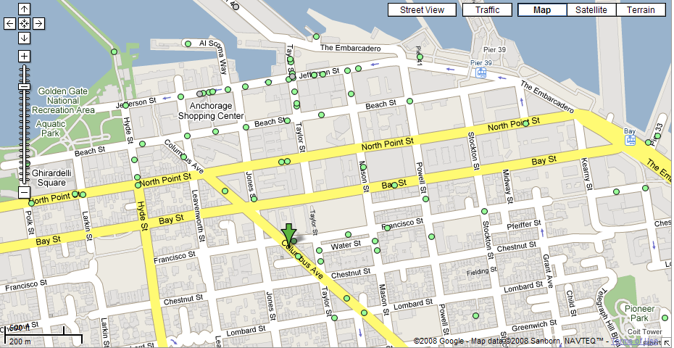
Nearest Neighbor(s) Query
素材来源于网络，版权归原作者
What is the closest restaurant to my hotel?
8

Slide 9
Nearest Neighbor(s) Query (cont’d)
素材来源于网络，版权归原作者
Find the 4 closest restaurants to my hotel
9

Slide 10
Multi-dimensional Query
In practice, queries might involve multi-dimensional keys.
key=(Name, Age): retrieve all records with
Name=“George” and “50 <= Age <= 70”
ID Name Age Salary #Children
10

Slide 11
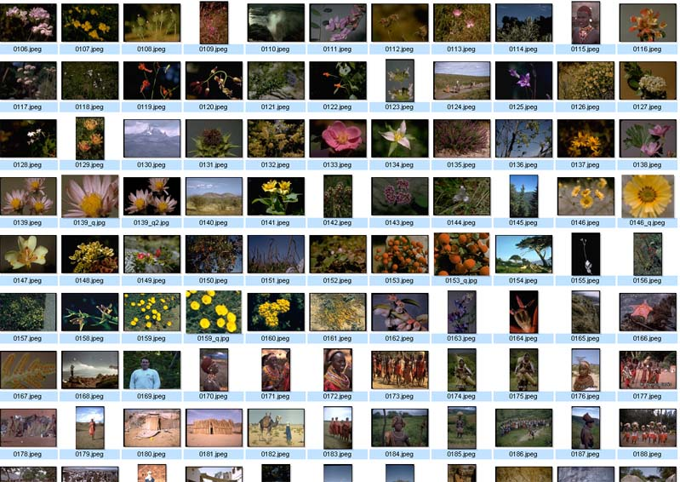
Nearest Neighbor Query in High Dimensions
素材来源于网络，版权归原作者
Very important and practical problem!
Image retrieval
find N closest
matches (i.e., N
nearest neighbors)
(f₁,f₂, .., f_{k})
11

Slide 12
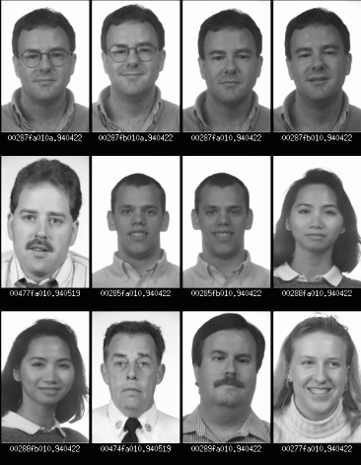
Nearest Neighbor Query in High Dimensions
素材来源于网络，版权归原作者
Face recognition
find closest match
(i.e., nearest neighbor)
12

Slide 13
We will discuss …
Range trees
KD-trees
Quadtrees
13

Slide 14
Interpreting Queries Geometrically
Multi-dimensional keys can be thought as “points” in high dimensional spaces.
Queries about records → Queries about points
14

Slide 15
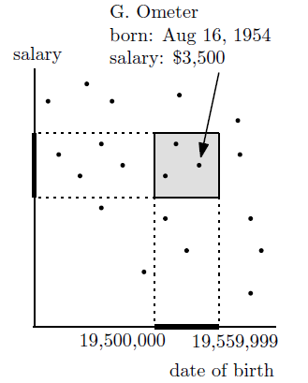
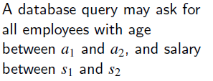
Example 1- Range Search in 2D
素材来源于网络，版权归原作者
age = 500,000 x year + 100 x month + day
15

Slide 16
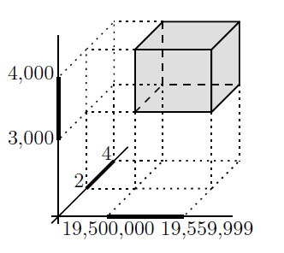
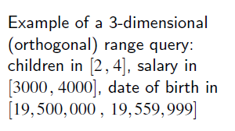
Example 2- Range Search in 3D
素材来源于网络，版权归原作者
16

Slide 17
Example 3- Nearest Neighbors Search
素材来源于网络，版权归原作者
QueryPoint
17

Slide 18
主要内容
Type of Queries
Range Tree
K-D Tree
Quad Trees
1D range search
2D range search
K-D tree construction
K-D tree exact search
K-D tree range search
nearest neighbor search
18
18

Slide 19
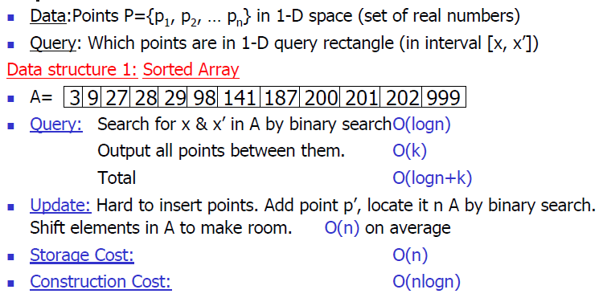
1D Range Search
素材来源于网络，版权归原作者
Data Structure 1: Sorted Array
Data Structure 2: BST
Data Structure 3: BST with data stored in leaves
19

Slide 20
1D Range Search Range: [x, x’]
Data Structure 1: Sorted Array
Does not generalize well to high dimensions.
Example: retrieve all points in [25, 90]
20

Slide 21


1D Range Search
Data Structure 2: BST
Search using binary search property.
Some subtrees are eliminated during search.
Search using:
Range: [l,r]
Prepare an array to save result.
Recursively search on the tree
private void rsearch(TreeNode root, int l, int r) {
if (root == null) {
return;
}
if (root.val > l) {
rsearch(root.left, l, r);
}
if (root.val >= l && root.val <= r) {
results.add(root.val);
}
if (root.val < r) {
rsearch(root.right, l, r);
}
l,r
x
If $l<$x
If $r>$x
Search left
Search right
x
x
Otherwise add x into results
21
Notes:
中序遍历

Slide 22
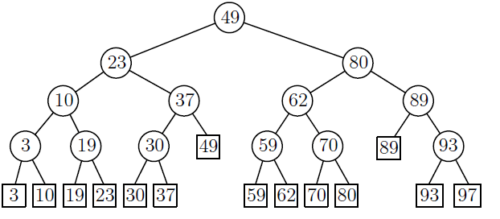
1D Range Search
Data Structure 2: BST
[25, 90]
[25, 90]
[25, 90]
[25, 90]
[25, 90]
[25, 90]
[25, 90]
[25, 90]
[25, 90]
Example: retrieve all points in [25, 90]
Results
30
37
49
59
62
70
80
89
The time complexity is O(logn + k), where k is the number in the range.
22
Notes:
Logn+k

Slide 23
1D Range Search
素材来源于网络，版权归原作者
Data Structure 3: BST with data stored in leaves
Internal nodes store splitting values (i.e., not necessarily same as data).
Data points are stored in the leaf nodes.
23

Slide 24
BST with data stored in leaves
Data Structure 3: BST with data stored in leaves
0
100
25
50
75
50
Data: 10, 39, 55, 120
25
75
10
39
55
120
24

Slide 25
1D Range Search
素材来源于网络，版权归原作者
Data Structure 3: BST with data stored in leaves
Retrieving data in [x, x’]
Perform binary search twice, once using x and the other using x’
Suppose binary search ends at leaves l and l’
The points in [x, x’] are the ones stored between l and l’ plus, possibly, the points stored in l and l’
25

Slide 26
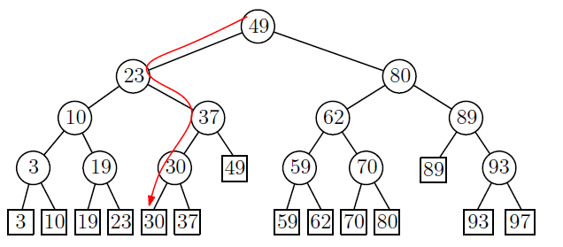
1D Range Search
素材来源于网络，版权归原作者
Data Structure 3: BST with data stored in leaves
Example: retrieve all points in [25, 90]
The search path for 25 is:
26

Slide 27
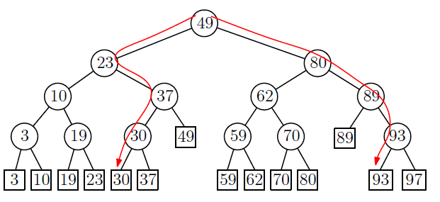
1D Range Search
素材来源于网络，版权归原作者
Data Structure 3: BST with data stored in leaves
The search for 90 is:
27

Slide 28
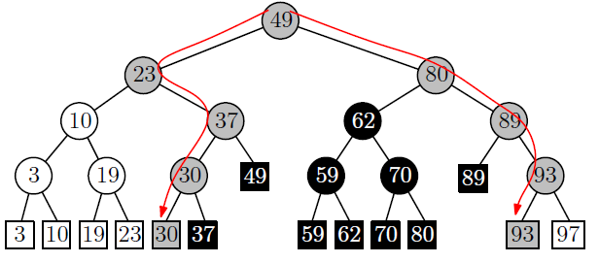
1D Range Search
素材来源于网络，版权归原作者
Data Structure 3: BST with data stored in leaves
Examine the leaves in the sub-trees between the two traversing paths from the root.
split node
retrieve all points in [25, 90]
28

Slide 29
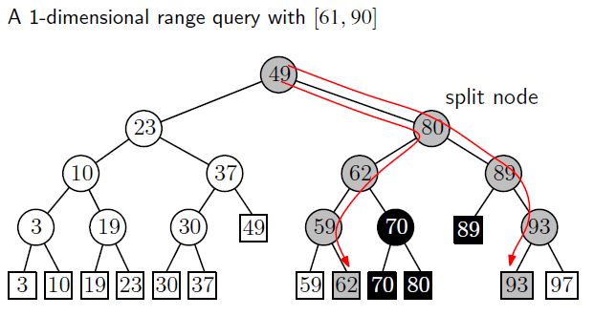
1D Range Search – Another Example
素材来源于网络，版权归原作者
Data Structure 3: BST with data stored in leaves
29

Slide 30
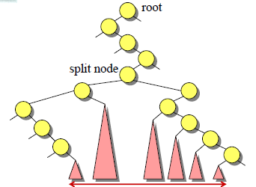
1D Range Search
素材来源于网络，版权归原作者
Data Structure 3: BST with data stored in leaves
How do we find the leaves of interest?
Find split node (i.e., node where the
paths to x and x’ split).
Left turn on left side: report leaves in right subtrees
Right turn on right side: report leaves in left substrees
Right turn on left side or right turn on left side, continue.
O(logn + k) time where k is the number of items reported.
30
Notes:
!!!

Slide 31
1D Range Search
素材来源于网络，版权归原作者
Data Structure 3: BST with data stored in leaves
Speed-up search by keeping the leaves in sorted order using a linked-list.
31

Slide 32
1D Range Search:总结
Data Structure 1: Sorted Array
O(logn + k)
Data Structure 2: BST
O(logn + k)
Data Structure 3: BST with data stored in leaves
O(logn + k)
32

Slide 33
主要内容
Type of Queries
Range Tree
K-D Tree
Quad Trees
1D range search
2D range search
K-D tree construction
K-D tree exact search
K-D tree range search
nearest neighbor search
33

Slide 34
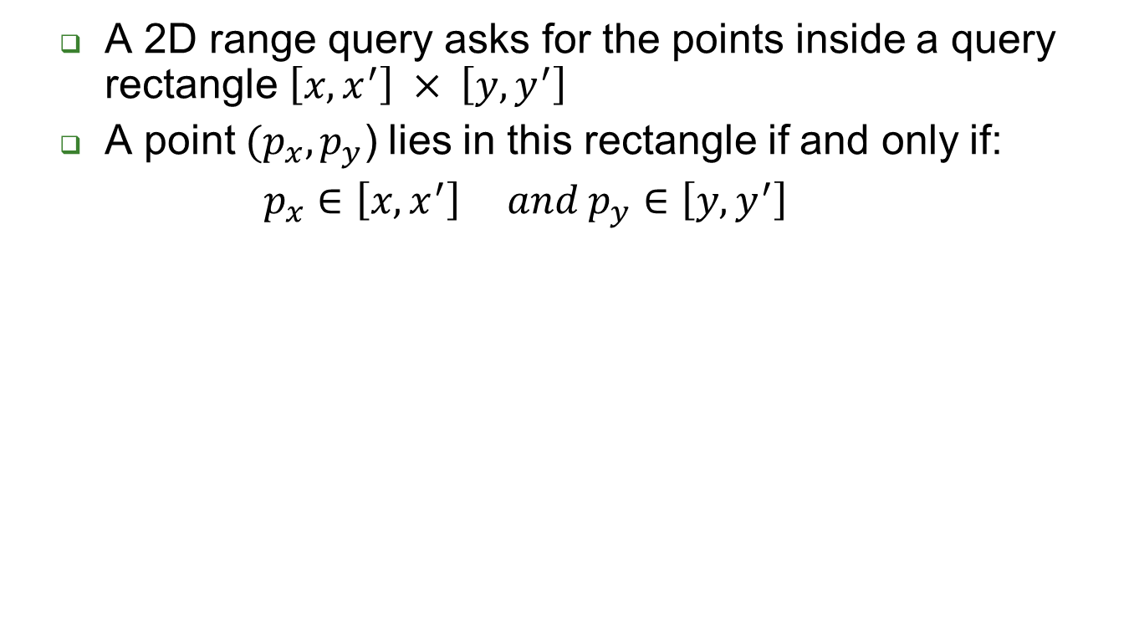


2D Range Search
素材来源于网络，版权归原作者
y’
y
34

Slide 35
2D Range Search (cont’d)
素材来源于网络，版权归原作者
A 2D range query can be decomposed in two 1D range queries:
One on the x-coordinate of the points.
The other on the y-coordinates of the points.
y’
y
35

Slide 36
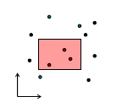
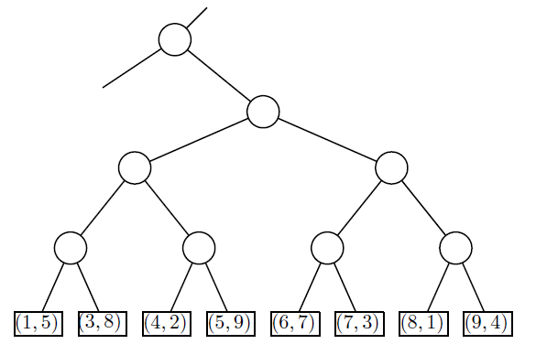
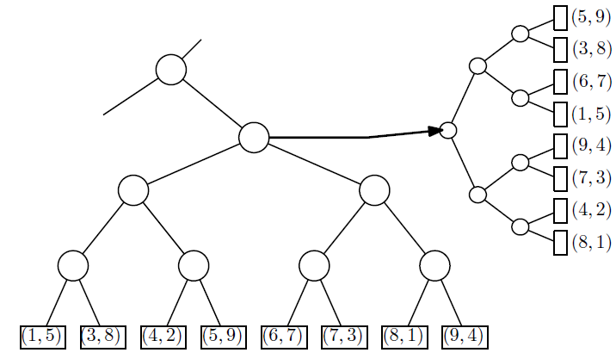
2D Range Search (cont’d)
素材来源于网络，版权归原作者
Store a primary 1D range tree for all the points based on x-coordinate.
For each node, store a secondary 1D range tree based on y-coordinate.
36

Slide 37
主要内容
Type of Queries
Range Tree
K-D Tree
Quad Trees
1D range search
2D range search
K-D tree construction
K-D tree exact search
K-D tree range search
nearest neighbor search
37

Slide 38
KD Tree
素材来源于网络，版权归原作者
A binary search tree where every node is a k-dimensional point.
Example: k=2
53, 14
27, 28
65, 51
Split by x-
30, 11
31, 85
70, 3
99, 90
Split by y-
40, 26
7, 39
32, 29
82, 64
Split by x-
29, 16
38, 23
55,62
73, 75
Split by y-
15, 61
38

Slide 39
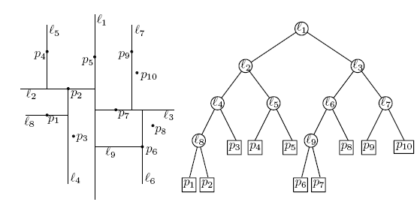
KD Tree (cont’d)
素材来源于网络，版权归原作者
Example: data stored at the leaves
39

Slide 40
KD Tree (cont’d)
素材来源于网络，版权归原作者
Every node (except leaves) represents a hyperplane that divides the space into two parts.
Points to the left (right) of this hyperplane represent the left (right) sub-tree of that node.
P_{left}
P_{right}
40

Slide 41
KD Tree (cont’d)
As we move down the tree, we divide the space along alternating (but not always) axis-aligned hyperplanes:
Split by x-coordinate: split by a vertical line that has (ideally) half the points left or on, and half right.
Split by y-coordinate: split by a horizontal line that has (ideally) half the points below or on and half above.
41

Slide 42
KD Tree-Example
素材来源于网络，版权归原作者
Split by x-coordinate: split by a vertical line that has approximately half the points left or on, and half right.
x
42

Slide 43
KD Tree-Example
素材来源于网络，版权归原作者
Split by y-coordinate: split by a horizontal line that has half the points below or on and half above.
x
y
y
43

Slide 44
KD Tree-Example
素材来源于网络，版权归原作者
Split by x-coordinate: split by a vertical line that has half the points left or on, and half right.
x
y
y
x
x
x
x
44

Slide 45
KD Tree-Example
素材来源于网络，版权归原作者
Split by y-coordinate: split by a horizontal line that has half the points below or on and half above.
x
y
y
x
x
x
x
y
y
45

Slide 46
Node Structure
素材来源于网络，版权归原作者
A KD-tree node has 5 fields
Splitting axis
Splitting value
Data
Left pointer
Right pointer
46

Slide 47
Splitting Strategies
Divide based on order of point insertion
Assumes that points are given one at a time.
Divide by finding median
Assumes all the points are available ahead of time.
Divide perpendicular to the axis with widest spread
Split axes might not alternate
… and more!
47

Slide 48
Example – using order of point insertion(data stored at nodes）
Insertion Order: (3, 6), (17, 15), (13, 15), (6, 12), (9, 1), (2, 7), (10, 19)
Node *insertRec(Node *root, int point[], unsigned depth)
{
if (root == NULL)
return newNode(point);
// 确定比较的维度
unsigned cd = depth % k;
// 与root的 cd 维数据进行对比
if (point[cd] < (root->point[cd]))
root->left =insertRec(root->left, point, depth + 1);
else
root->right =insertRec(root->right, point, depth + 1);
return root;
}
(3, 6)
X
(2, 7)
(17, 15)
Y
(6, 12)
(13, 15)
X
(9, 1)
(10, 19)
Y
Node* insert(Node *root, int point[])
{
return insertRec(root, point, 0);
}
48

Slide 49
Example – using order of point insertion(data stored at nodes
Like a BST, we would expect insert to take O(logn), since we do a path from root to leaf and in a balanced tree the depth is logn, where n is the number of nodes (equivalent to the number of points).
However, there is a clear degenerate case: if each point increases along every dimension, then the tree becomes a line with height O(n). 1+2+···+n = O(n²), so it might take quadratic time to build a kd-tree in the worst case.
In practice, the points are commonly known ahead of time. Can we guarantee an O(n log n) build over n points if we know the n points ahead of time?
49

Slide 50
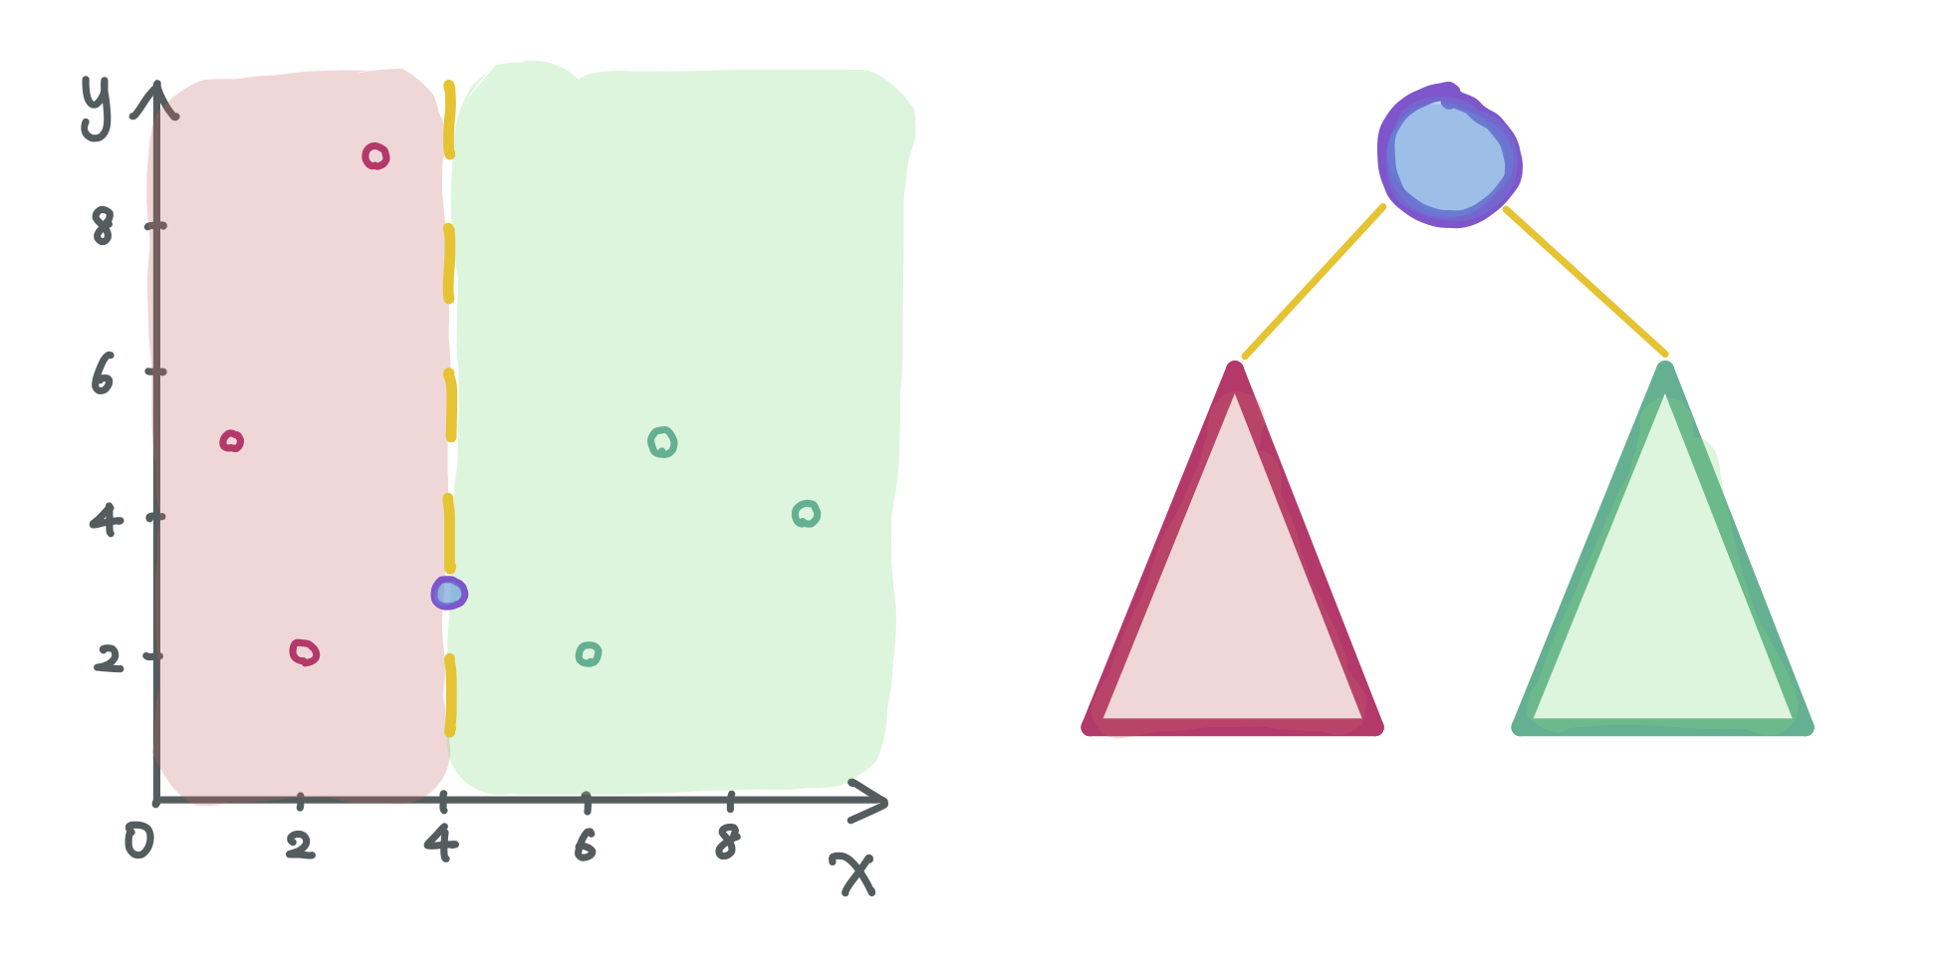
Median-based Construction
素材来源于网络，版权归原作者
The key insight is that splitting the points perfectly in half between the two subtrees is the best possible split. This means we should split based on the median value.
50

Slide 51
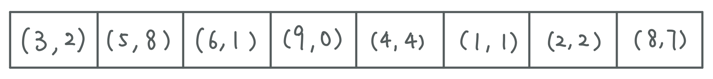
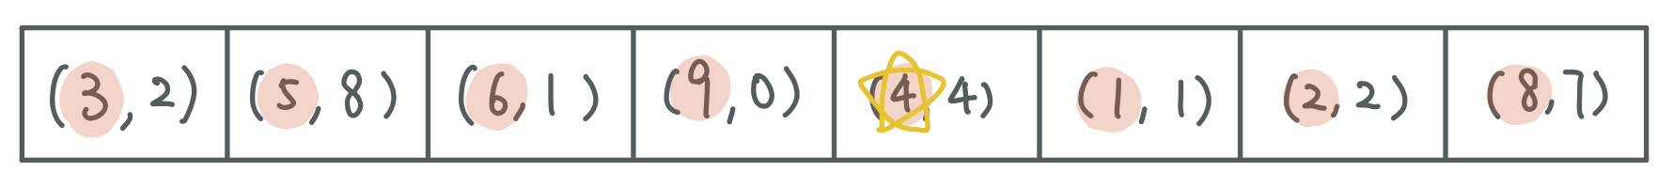
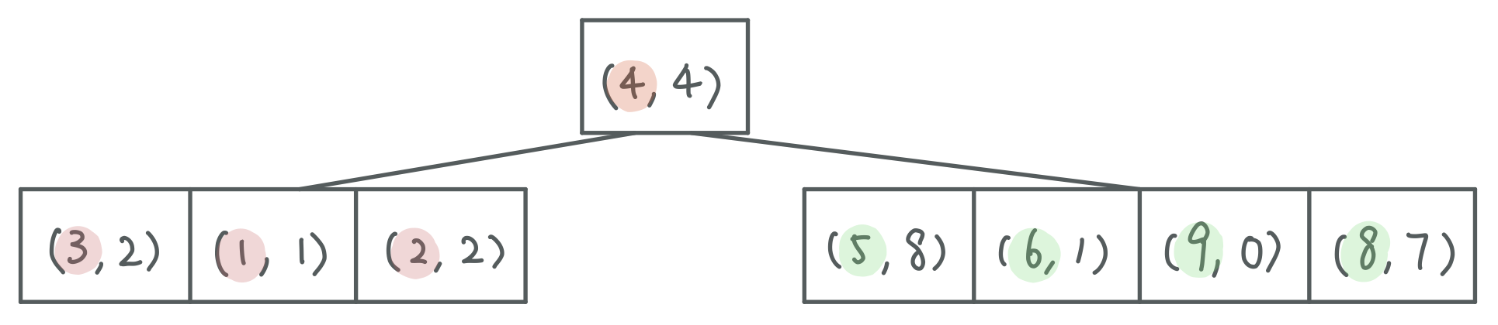
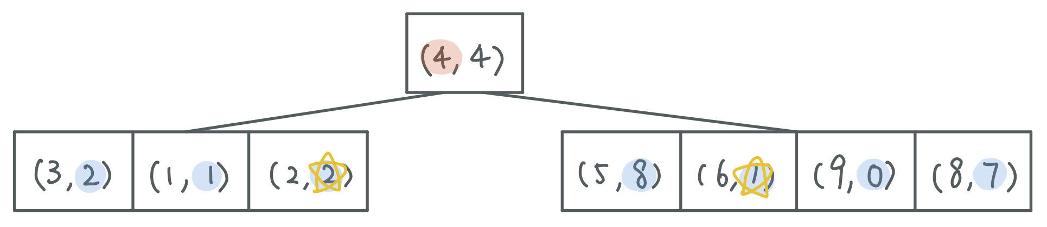
素材来源于网络，版权归原作者
51

Slide 52
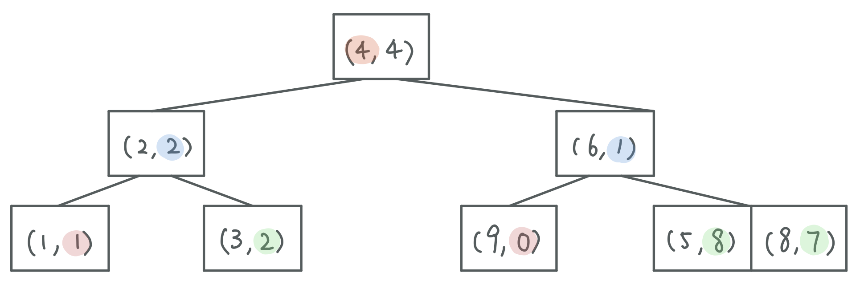
素材来源于网络，版权归原作者
52

Slide 53
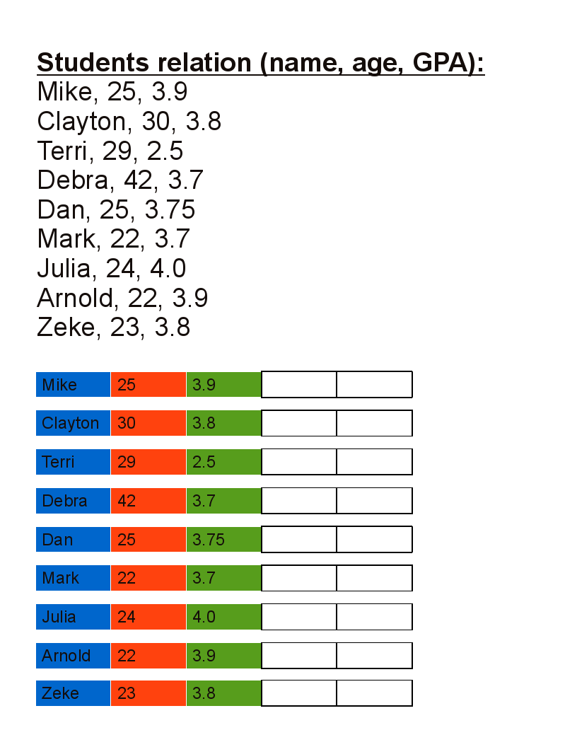
Another Example – using median
素材来源于网络，版权归原作者
53

Slide 54
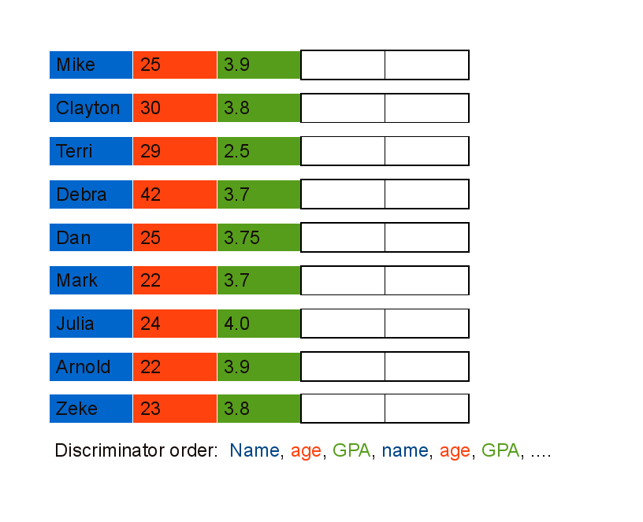
Another Example – using median
素材来源于网络，版权归原作者
54

Slide 55
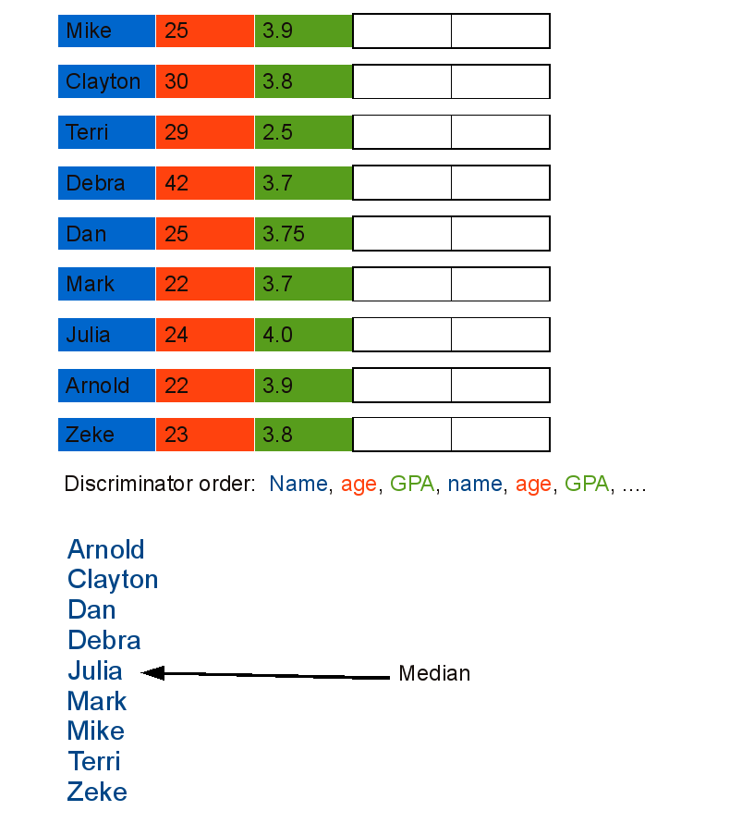
Another Example – using median
素材来源于网络，版权归原作者
55

Slide 56
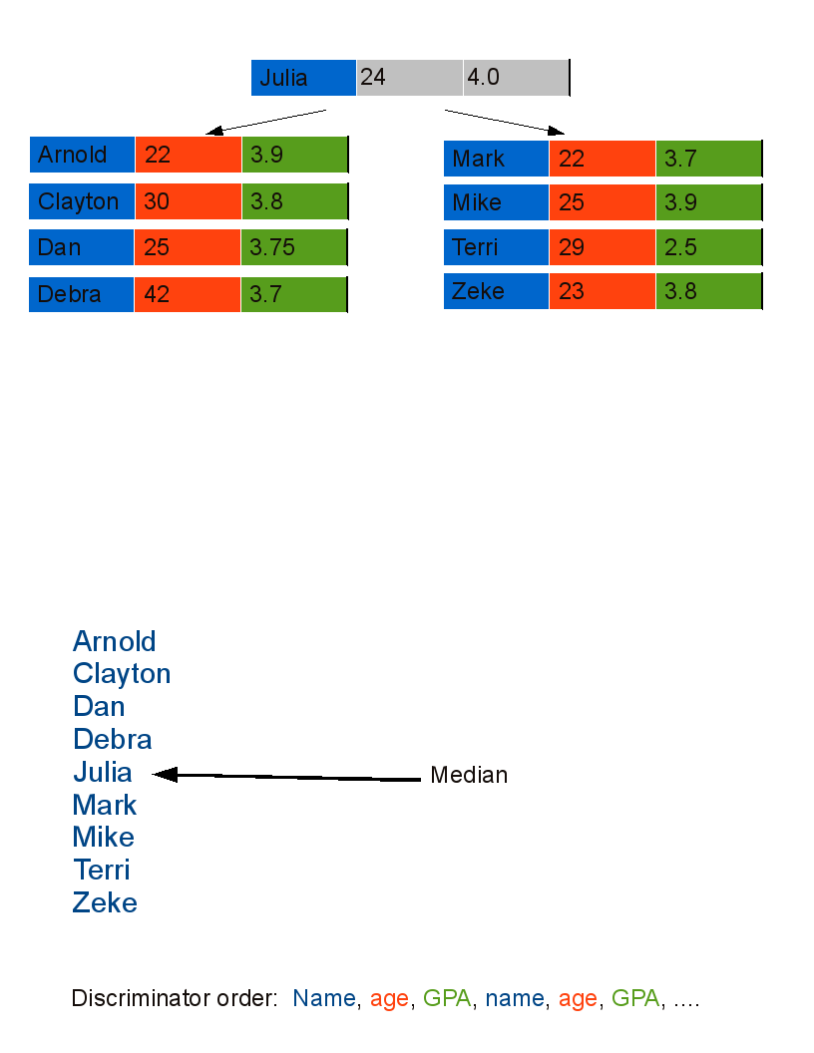
Another Example – using median
素材来源于网络，版权归原作者
56

Slide 57
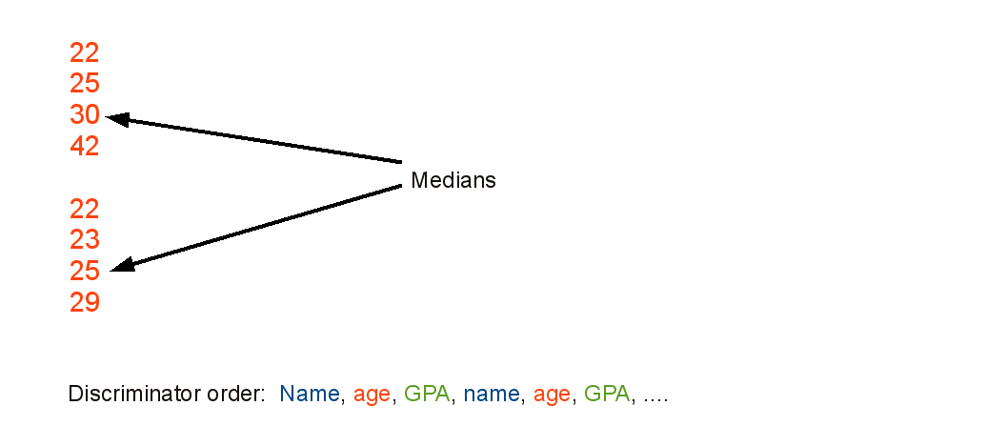
Another Example – using median
素材来源于网络，版权归原作者
57

Slide 58
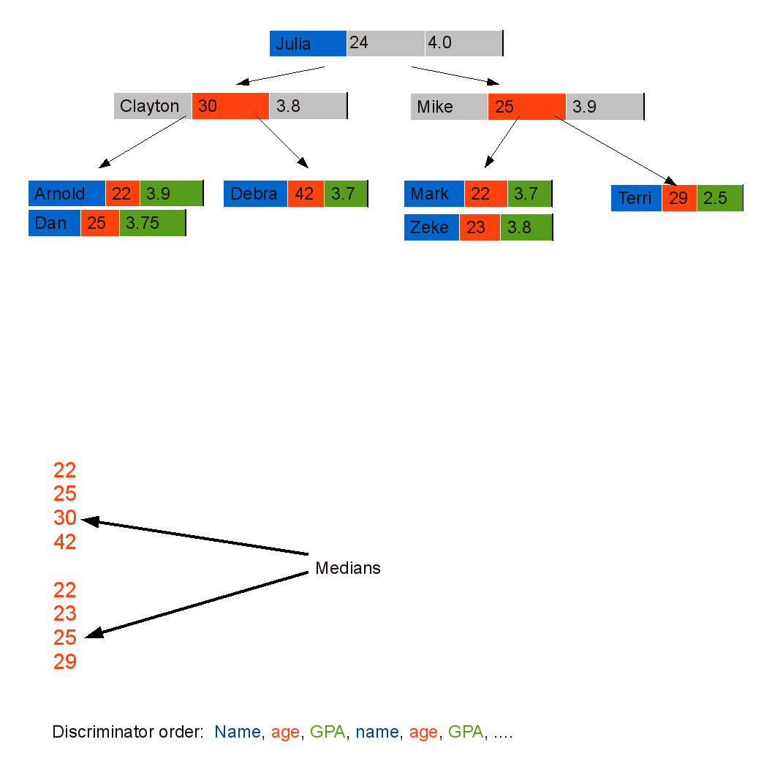
Another Example – using median
素材来源于网络，版权归原作者
58

Slide 59
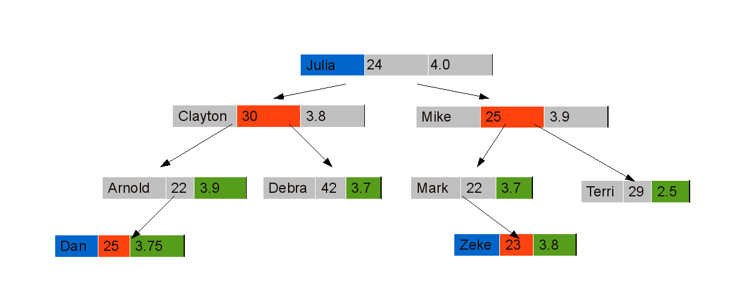
Another Example – using median
素材来源于网络，版权归原作者
59

Slide 60
KD Tree (cont’d)
Let’s discuss
Insert
Delete
Search
60

Slide 61
Insert (55, 62)
Insert new data
素材来源于网络，版权归原作者
55 > 53, move right
53, 14
x
62 > 51, move right
27, 28
65, 51
y
70, 3
99, 90
x
30, 11
31, 85
55 < 99, move left
29, 16
40, 26
7, 39
32, 29
82, 64
y
38, 23
55,62
73, 75
15, 61
62 < 64, move left
Null pointer, attach
61
Notes:
61

Slide 62
Delete data
1) If current node contains the point to be deleted
If it is a leaf node, simply delete it (Same as BST Delete)
If it has right child (Different from BST)
在右侧子树中查找当前节点维度的最小值。
用找到的最小值替换节点。
Else If it has left child (Different from BST)
在左侧子树中查找当前节点维度的最小值。
用找到的最小值替换节点，并递归地删除左子树中的最小值。
将新的左子树作为当前节点的右子树。
2) If current is not the point to be deleted
If node to be deleted is smaller than current node on current dimension, recur for left subtree.
Else recur for right subtree.
62

Slide 63
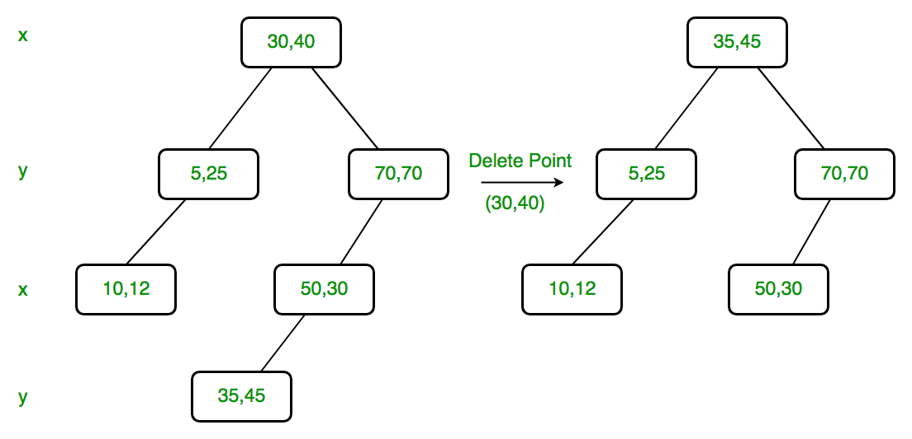
K-D Tree Deletion
素材来源于网络，版权归原作者
Since right child is not NULL and dimension of node is x, we find the node with the minimum x value in the right child.
we replace (30, 40) with (35, 45) and delete (30, 40).
63

Slide 64
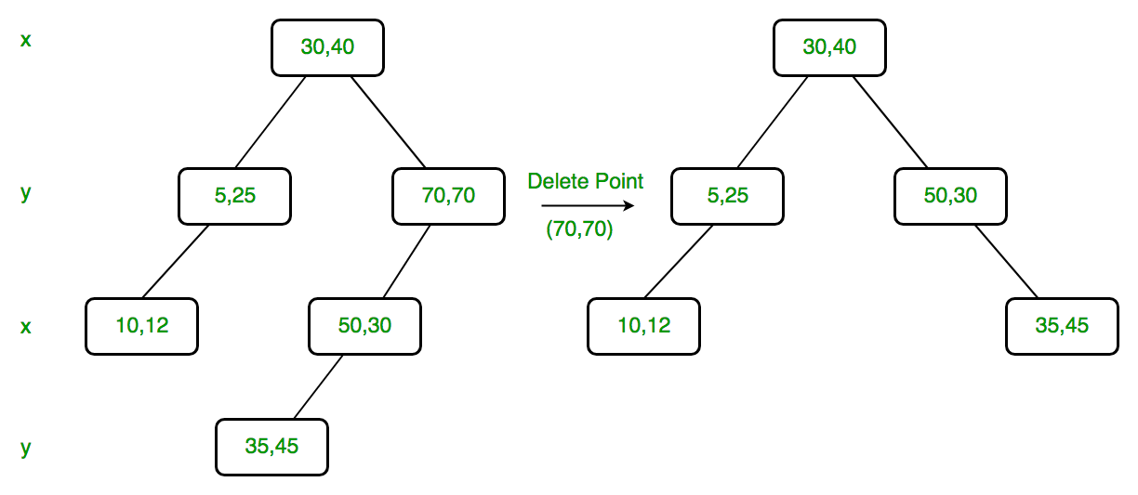
K-D Tree Deletion
素材来源于网络，版权归原作者
Delete (70, 70)
we replace (70, 70) with (50, 30)
recursively delete (50, 30) in left subtree.
Finally we make the modified left subtree as right subtree of (50, 30).
Dimension of node is y. Since right child is NULL, we find the node with minimum y value in left child.
64

Slide 65
Node *deleteNodeRec(Node *root, int point[], int depth)
{
// Given point is not present
if (root == NULL)
return NULL;
// Find dimension of current node
int cd = depth % k;
// If the point to be deleted is present at root
if (arePointsSame(root->point, point))
{
// 2.b) If right child is not NULL
if (root->right != NULL)
{
// Find minimum of root's dimension in right subtree
Node *min = findMin(root->right, cd);
// Copy the minimum to root
copyPoint(root->point, min->point);
// Recursively delete the minimum
root->right = deleteNodeRec(root->right, min->point, depth+1);
}
else if (root->left != NULL) // same as above
{
Node *min = findMin(root->left, cd);
copyPoint(root->point, min->point);
root->right = deleteNodeRec(root->left, min->point, depth+1);
}
else // If node to be deleted is leaf node
{
delete root;
return NULL;
}
return root;
}
65

Slide 66

Search in K-D Tree
素材来源于网络，版权归原作者
Exact Search
Range Search
66

Slide 67
主要内容
Type of Queries
Range Tree
K-D Tree
Quad Trees
1D range search
2D range search
K-D tree construction
K-D tree exact search
K-D tree range search
nearest neighbor search
67

Slide 68
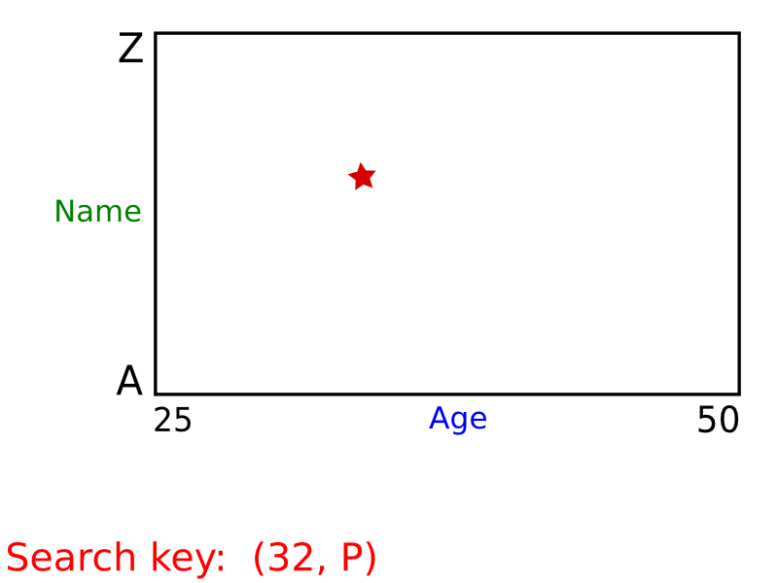
KD Tree – Exact Search
素材来源于网络，版权归原作者
68

Slide 69
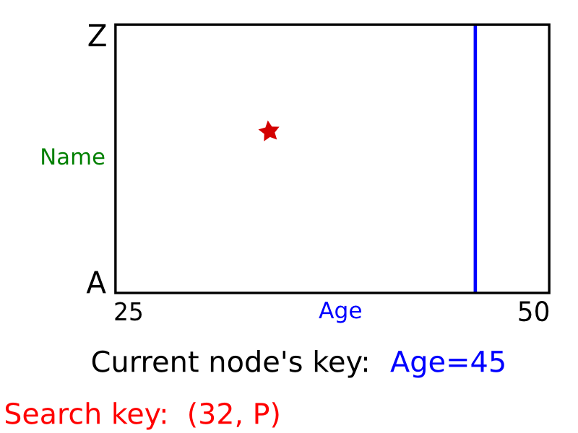
KD Tree – Exact Search
素材来源于网络，版权归原作者
69

Slide 70
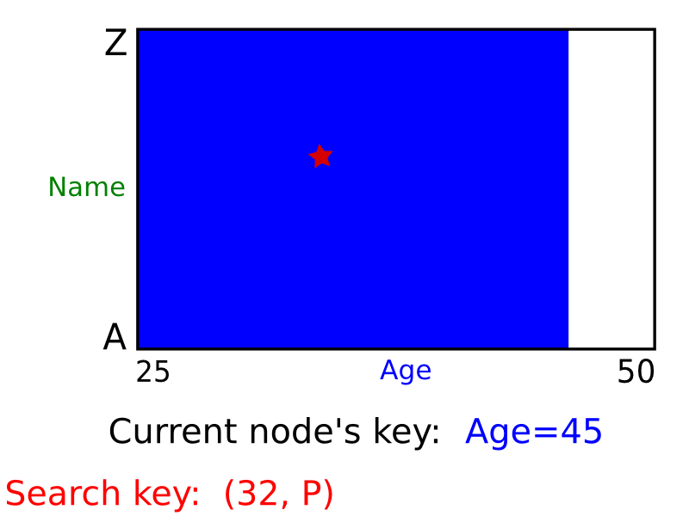
KD Tree – Exact Search
素材来源于网络，版权归原作者
70

Slide 71
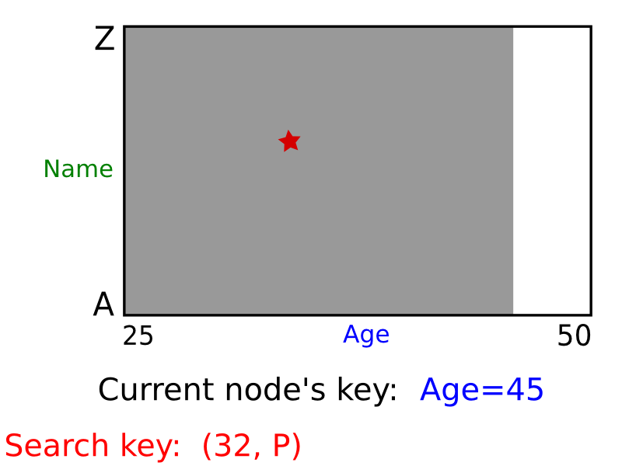
KD Tree – Exact Search
素材来源于网络，版权归原作者
71

Slide 72
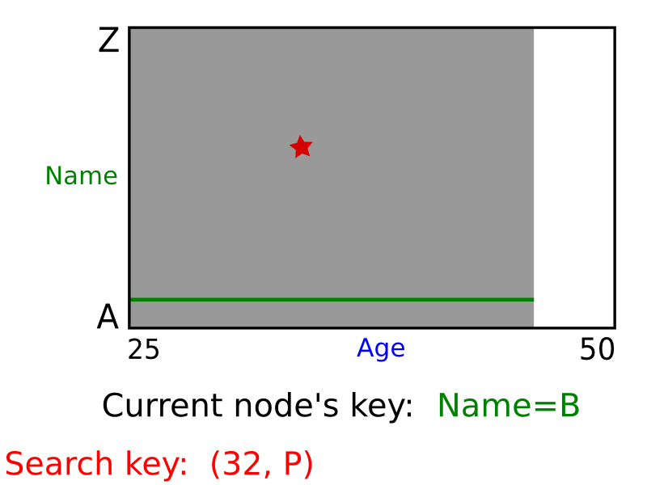
KD Tree – Exact Search
素材来源于网络，版权归原作者
72

Slide 73
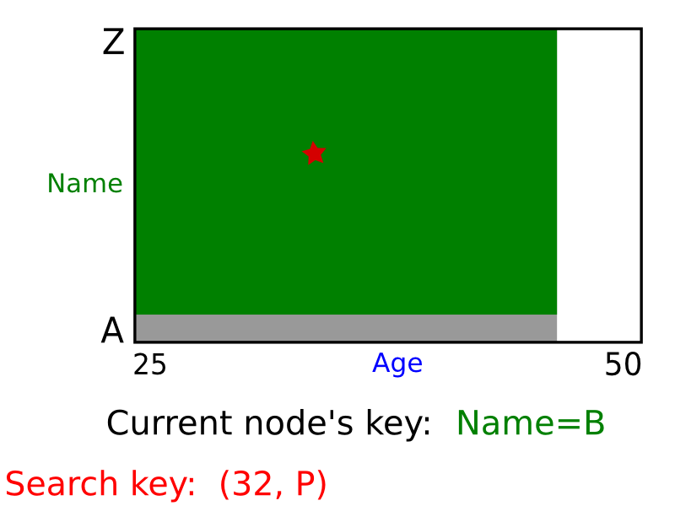
KD Tree – Exact Search
素材来源于网络，版权归原作者
73

Slide 74
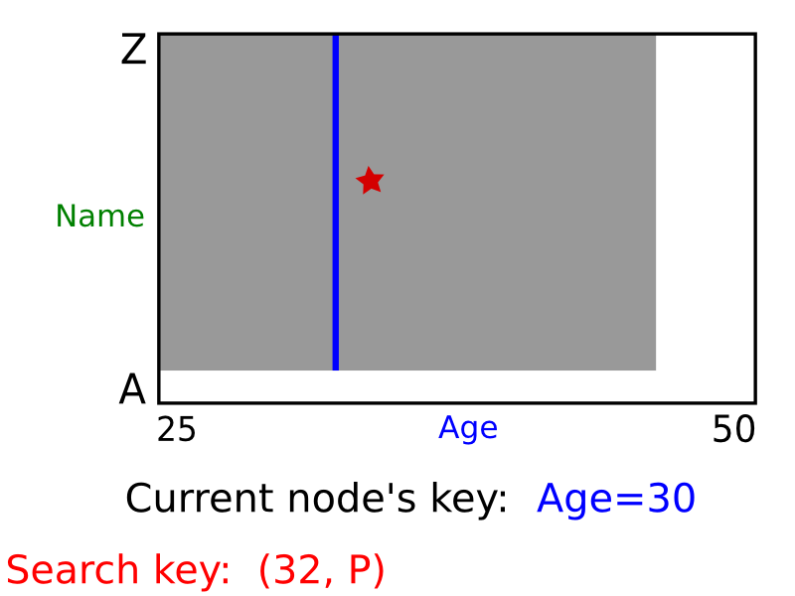
KD Tree – Exact Search
素材来源于网络，版权归原作者
74

Slide 75
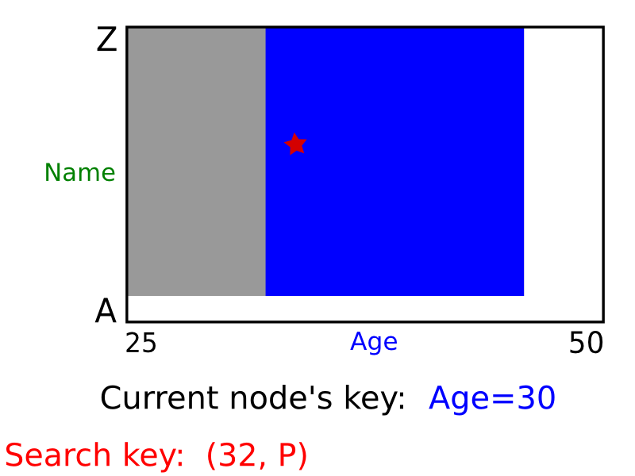
KD Tree – Exact Search
素材来源于网络，版权归原作者
75

Slide 76
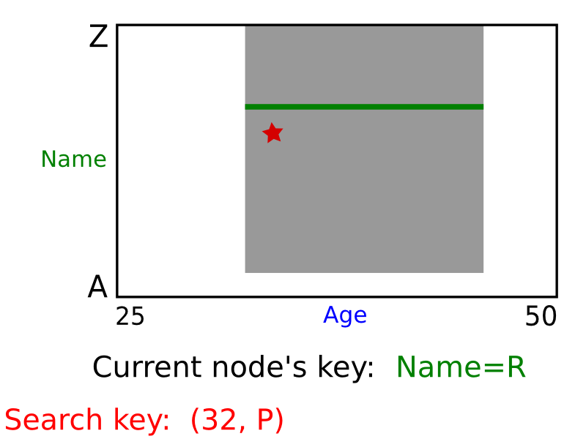
KD Tree – Exact Search
素材来源于网络，版权归原作者
76

Slide 77
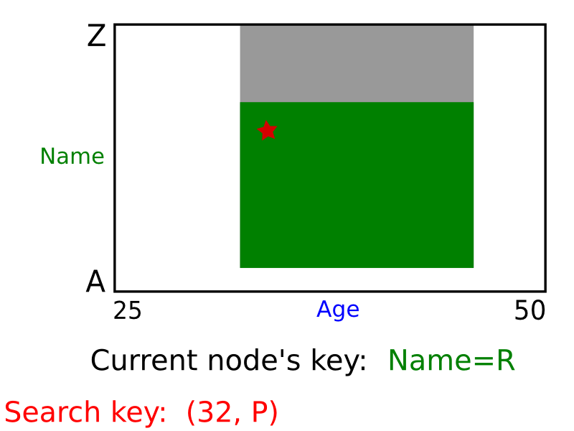
KD Tree – Exact Search
素材来源于网络，版权归原作者
77

Slide 78
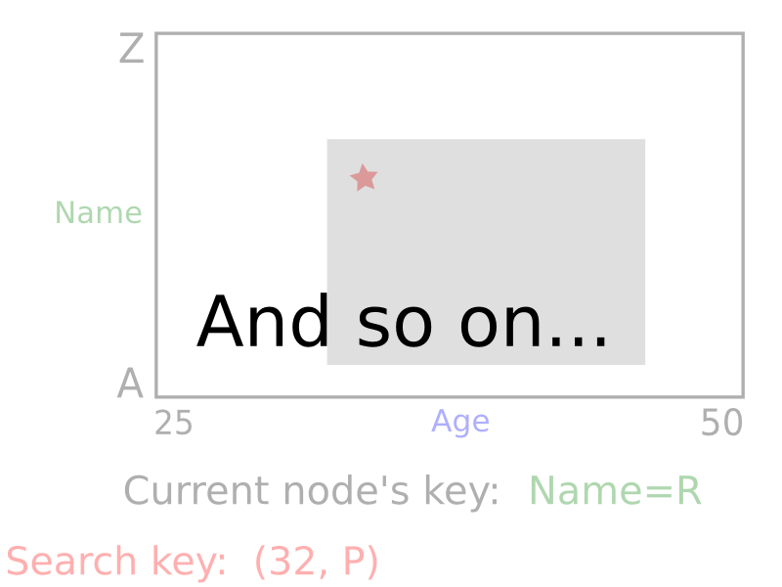
KD Tree – Exact Search
素材来源于网络，版权归原作者
Exact search is just like the sequential insertion process
78

Slide 79
KD Tree – Range Search
素材来源于网络，版权归原作者
2D Orthogonal Range Query
• Data: A set S of n points
• Query: Report/Count subset of S that lie in a rectangle range
79

Slide 80
KD Tree – Range Search
素材来源于网络，版权归原作者
We store the data in a KD Tree
80

Slide 81
KD Tree – Range Search
素材来源于网络，版权归原作者
The range query problem becomes a KD-Tree range query problem.
81

Slide 82
KD Tree – Range Search
素材来源于网络，版权归原作者
Let’s firstly make clear a concept: Region of a node on KD-tree
The region of a node is the region characterized by the ancestors of the node.
The region of the root node is the full 2D plan because it doesn’t has an ancestor.
82

Slide 83


Region of a node on KD-Tree
素材来源于网络，版权归原作者
Region(l₂) = the left half plane of Region(l₁)
$$region\left(lc\left(v\right)\right)=region(v)∩{l(v)}^{left}$$
Region(l₃) = the right half plane of Region(l₁)
$$region\left(rc\left(v\right)\right)=region(v)∩{l(v)}^{right}$$
83

Slide 84
Region of a node on KD-Tree
素材来源于网络，版权归原作者
Region(l₄) = the down half plane of Region(l₂) seperated by l₂
Region(l₅) = the up half plane of Region(l₂) seperated by l₂
How to represent and how to record region for a node?
84

Slide 85
KD-Tree Node data structure
class Node
{
public:
Node* left; //left child
Node* right; //right child
int begin; //start index [close
int end; //end index (open
Dimension dimension; //cut dimension
double pivot; //cut value
Node(int b, int e, Dimension dim, double piv);
bool IsLeaf() const;
BBox LeftSubTreeEnvelope(const BBox& current_entext) const;
BBox RightSubTreeEnvelope(const BBox& current_entext) const;
};
85

Slide 86
Region of a node on KD-Tree
素材来源于网络，版权归原作者
BBox::BBox(double x0, double x1, double y0, double y1) :
xmin(x0), xmax(x1), ymin(y0), ymax(y1),
{}
某节点的左子树的Region范围
BBox Node::LeftSubTreeEnvelope(const BBox& current_entext) const{
BBox leftRegion(current_entext);
//继承父节点的region
switch (dimension){
case X:
leftRegion.xmax = pivot;
//x方向最大值设为此节点x值
break;
case Y:
leftRegion.ymax = pivot;
//y方向最大值设为此节点y值
break;
}
return leftRegion;
}
86

Slide 87
Region of a node on KD-Tree
素材来源于网络，版权归原作者
BBox Node::RightSubTreeEnvelope(const BBox& current_entext) const
{
BBox rightRegion(current_entext);
switch (dimension)
{
case X:
rightRegion.xmin = pivot;
//修改x方向最小值
break;
case Y:
rightRegion.ymin = pivot;
// 修改y方向最小值
break;
}
return rightRegion;
}
87

Slide 88
Region of a node on KD-Tree
素材来源于网络，版权归原作者
这样无需存储，而是可以在线遍历节点的时候，实时计算节点的region
88

Slide 89
Region Search in a KD-Tree
素材来源于网络，版权归原作者
89

Slide 90
Region Search in a KD-Tree
素材来源于网络，版权归原作者
90

Slide 91
Region Search in a KD-Tree
素材来源于网络，版权归原作者
91

Slide 92
Region Search in a KD-Tree
素材来源于网络，版权归原作者
92

Slide 93
Region Search in a KD-Tree
素材来源于网络，版权归原作者
93

Slide 94
Region Search in a KD-Tree
素材来源于网络，版权归原作者
94

Slide 95
Region Search in a KD-Tree
素材来源于网络，版权归原作者
Range of # lies within the query range. The whole subtree rooted at # is reported.
95

Slide 96
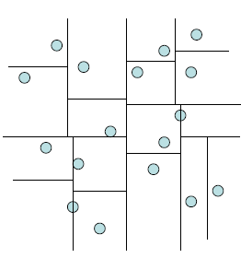
KD Trees – Range Search
素材来源于网络，版权归原作者
query range
Need only search nodes whose region intersects query region.
Report all points in subtrees whose regions are entirely contained in query range.
If a region is partially contained in the query range then recursively query the subtrees.
96

Slide 97
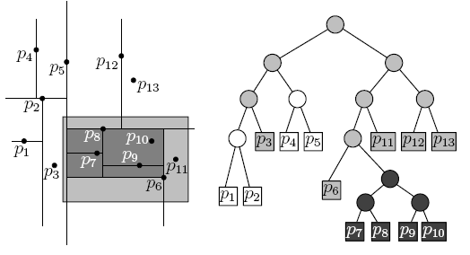
Example – Range Search
素材来源于网络，版权归原作者
All other nodes visited (i.e., gray) correspond to regions
that are only partially inside the query rectangle.
- Report points p₆ and p₁₁ only
- Do not report points p₃, p₁₂ and p₁₃
97

Slide 98
Query a K-d tree
素材来源于网络，版权归原作者
Time complexity analysis
Query(t,r) is called if t’s parent’s region intersects (but does not lie inside) r
Such region must contain a border edge of r
98

Slide 99
Time complexity of Range Search in K-D Tree
素材来源于网络，版权归原作者
How many nodes of a k-d tree can be “stabbed”(刺穿) by a line (i.e., the line passes through the node’s region)?
99

Slide 100
Time complexity of Range Search in K-D Tree
素材来源于网络，版权归原作者
100

Slide 101
Time complexity of Range Search in K-D Tree
素材来源于网络，版权归原作者
101

Slide 102
Time complexity of Range Search in K-D Tree
素材来源于网络，版权归原作者
102

Slide 103

Time complexity of Range Search in K-D Tree
素材来源于网络，版权归原作者
log(n)
$2^{\frac{logn}{2}}$=$\sqrt{n}$
103

Slide 104
Time complexity of Range Search in K-D Tree
104

Slide 105
Time complexity of Range Search in K-D Tree
Suppose there are k nodes in the range
105

Slide 106
总结：KD Tree (vs Range tree) in d-dimensions
Construction→ O(dnlogn)
Sort points in each dimension: O(dnlogn)
Determine splitting line (median finding): O(dn)
Space requirements:
KD tree: O(n)
Range tree: O(nlog^{d-1}n)
Query requirements:
KD tree: O(n^{1-1/d}+k)
Range tree: O(log^{d}n+k)
O(n+k) as d increases!
106
Notes:
106

Slide 107

主要内容
Nearest Neighbor Search
NN Search in Quad Tree
NN Search in K-D Tree
Quad Tree Construction
Exact Query
NN search in K-D Tree
Nearest Neighbor Query
Variants of NN Search
PCP Tree
Approximate NN in K-D Tree
ε‐Approximate NN in K-D Tree
107

Slide 108
Nearest Neighbor (NN) Search
Given: a set P of n points in R^{d}，a query q
Goal: find the nearest neighbor p of q in P
p
q
Euclidean distance
108

Slide 109
Nearest Neighbor (NN) Search
Naïve approach
Compute the distance from the query point to every other point in the database, keeping track of the "best so far".
Running time is O(n).
p
q
109

Slide 110
Array (Grid) Structure
(1) Subdivide the plane into a grid of M x N square cells (same size)
(2) Assign each point to the cell that contains it.
(3) Store as a 2-D (or N-D in general) array:
“each cell contains a link to a list of points stored in that cell”
p₁
p₁,p₂
p₂
110

Slide 111
Array (Grid) Structure
Algorithm
* Look up cell holding query point.
* First examine the cell containing the query,
then the cells adjacent to the query
(i.e., there could be points in adjacent
cells that are closer).
Comments
* 如果点分布不均匀，则均匀网格效率低下。.
- Too close together: long lists in each grid, serial search.
- Too far apart: search large number of neighbors.
* Multiresolution grid can address some of these issues.
p₁
q
p₂
111

Slide 112
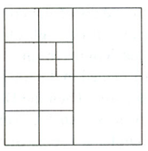
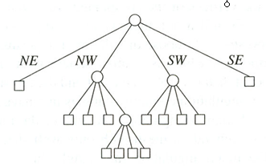
Quadtree
A tree in which each internal node has up to four children.
Every node in the quadtree corresponds to a square.
The children of a node v correspond to the four quadrants of the square of v.
The children of a node are labelled NE, NW, SW, and SE to indicate to which quadrant they correspond.
NW
N
NE
W
E
SW
S
SE
Notes:
Extension to the K-dimensional case

Slide 113
Quadtree Construction
(data stored at leaves)
400
a
Input: point set P
while Some cell C contains more than “k” points do
Split cell C
end
b
c
d
e
Y
g
f
h
l
j
i
k
X 50, Y 200
0
X
100
SW
SE
NW
NE
i h
X 75, Y 100
c e
X 25, Y 300
j k
f
g l
d
a b
113

Slide 114
Quadtree – Exact Match Query
Partitioning of the plane
The quad tree
D(35,85)
A(50,50)
•
•
B(75,80)
P
SW
SE
NE
•
NW
NE
C(90,65)
SW
B(75,80)
•
NE
A(50,50)
E
D
SE
SW
NW
•
C
E(25,25)
To search for P(55, 75):
Since X_{A}< X_{P} and Y_{A} < Y_{P} → go to NE (i.e., B).
Since X_{B} > X_{P} and Y_{B} > Y_{P} → go to SW, which in this case is null.
114
Notes:
Multimedia Technologies
7/17/97
Kien A. Hua
114

Slide 115
Quadtree – Nearest Neighbor Query
N
X₁,Y₁
SW
SE
NE
NW
W
E
X₂,Y₂
Y
S
X
115
Notes:
Extension to the K-dimensional case

Slide 116
Quadtree – Nearest Neighbor Query
找到q所在的最细粒度的cell
X₁,Y₁
SW
NE
q
NW
SE
X₂,Y₂
Y
NW
X
116
Notes:
Extension to the K-dimensional case

Slide 117
Quadtree – Nearest Neighbor Query
最近邻不一定在q所在的cell中
X₁,Y₁
SW
NE
NW
SE
X₂,Y₂
A
SW
q
B
SE
NE
Y
NW
q
B
A
X
117
Notes:
Extension to the K-dimensional case

Slide 118
Quadtree– Nearest Neighbor Search
Algorithm
Initialize range search with a large range r
Put the root on a stack
Repeat
Pop the next node T from the stack
For each child C of T
if C intersects with a circle (ball) of radius r around q, add C to the stack
if C is a leaf, examine point(s) in C and
update r
N
(x₂,y₂)
(x₃,y₃)
q
W
(x₁,y₁)
E
S
x₁,y₁
NE
SW
NW
SE
x₂,y₂
SW
NE
NW
SE
Whenever a point is found, update r (i.e., the current minimum)
Only investigate nodes with respect to current r.
x₃,y₃
118

Slide 119
N
x₁,y₁
NE
SW
NW
(x₂,y₂)
(x₃,y₃)
SE
x₂,y₂
q
SW
NE
(x₁,y₁)
E
NW
SE
W
x₃,y₃
r
S
Process T.NW.NE.SW
r is reduced.
Process T.NW.NE.NW
Process T.NW.NE.SE
Process T.NW.NE.NE
Process T.SW
r is reduced.
Process T.NW.SE
r is reduced.
T
T.NW
Process T.NE
T.NW.NE
119

Slide 120
Quadtree(cont’d)
Simple data structure.
Easy to implement.
But, it might not be efficient:
A quadtree could have a lot of empty cells.
If the points form sparse clouds, it takes a while to reach nearest neighbors.
120

Slide 121
主要内容
Nearest Neighbor Search
NN Search in Quad Tree
NN Search in K-D Tree
Quad Tree Construction
Exact Query
NN search in K-D Tree
Nearest Neighbor Query
Variants of NN Search
PCP Tree
Approximate NN in K-D Tree
ε‐Approximate NN in K-D Tree
121

Slide 122
NN Search in K-D Tree
Nearest Neighbor Queries using K-D Tree are very common: given a point q find the point p in the data set that is closest to q.
Finding the cell that contains q and returns the points in the cell doesn’t work.
(52,52)
122

Slide 123
最近邻点不一定在q所在的cell内，需要进行回溯查找
123

Slide 124
NN Search in K-D Tree, Ideas
Idea: traverse the whole tree, BUT make two modifications to prune search spaces:
Keep a variable of closest point C found so far. Prune subtrees once their bounding boxes can’t contain any point closer than C.
Search the subtrees in order that maximizes the chance for pruning.
By starting with the the subtree that would contain Q
Then recursively examine the subtrees that may contain points “closer” to Q
124

Slide 125
NN Search in K-D Tree, Ideas
If d > dist(C, Q), then no point in BB(T) can be closer to Q than C. Hence, no reason to search subtree rooted at T.
Update the best point so far, if T is better:
if dist(C, Q) > dist(T.data, Q), C := T.data
Recurse, but start with the subtree “closer” to Q:
125

Slide 126
Nearest Neighbor with KD Trees
Traverse the tree, looking for the rectangle that contains the query.
126

Slide 127
Nearest Neighbor with KD Trees
Nearest Neighbor with KD Trees
Explore the branch of the tree that is closest to the query point first.
127

Slide 128
Nearest Neighbor with KD Trees
Explore the branch of the tree that is closest to the query point first.
128

Slide 129
Nearest Neighbor with KD Trees
When we reach a leaf, compute the distance to each point in the node.
129

Slide 130
Nearest Neighbor with KD Trees
When we reach a leaf, compute the distance to each point in the node.
130

Slide 131
Nearest Neighbor with KD Trees
Then, backtrack and try the other branch at each node visited.
131

Slide 132
Nearest Neighbor with KD Trees
Each time a new closest node is found, we can update the distance bounds.
132

Slide 133
Nearest Neighbor with KD Trees
Each time a new closest node is found, we can update the distance bounds.
133

Slide 134
Nearest Neighbor with KD Trees
Using the distance bounds and the bounds of the data below each node, we can prune parts of the tree that could NOT include the nearest neighbor.
134

Slide 135
Nearest Neighbor with KD Trees
Using the distance bounds and the bounds of the data below each node, we can prune parts of the tree that could NOT include the nearest neighbor.
135

Slide 136
Nearest Neighbor with KD Trees
Using the distance bounds and the bounds of the data below each node, we can prune parts of the tree that could NOT include the nearest neighbor.
136

Slide 137
Nearest Neighbor with KD Trees
nearNeighbor(q, p, cell, bestDist)
the query point q
the current node p of the tree
the rectangular cell associated with this node
the smallest distance, bestDist, between q and any point seen so far in the search.
137

Slide 138
float nearNeighbor(Point q, KDNode p, Rectangle cell, float bestDist) {
if (p != null) {
float thisDist = q.distanceTo(p.point); //查询点和p.point距离
bestDist = Math.min(thisDist, bestDist);
int cd = p.cutDim;
Rectangle leftCell = cell.leftPart(cd, p.point);
Rectangle rightCell = cell.rightPart(cd, p.point); // right child’s cell
if (q[cd] < p.point[cd]) { // q 距离左分支更近 bestDist = nearNeighbor(q, p.left, leftCell, bestDist);
if (rightCell.distanceTo(q) < bestDist) { // worth visiting right? bestDist = nearNeighbor(q, p.right, rightCell, bestDist);
}
} else { // q 离右分支更近
bestDist = nearNeighbor(q, p.right, rightCell, bestDist);
if (leftCell.distanceTo(q) < bestDist) { // worth visiting left?
bestDist = nearNeighbor(q, p.left, leftCell, bestDist);
}} }
return bestDist;
}
138

Slide 139
if (q[cd] < p.point[cd])
if (rightCell.distanceTo(q) < bestDist)
139

Slide 140
NN example using kD trees
d=1 (binary search tree)
5
20
7
8
10
12
13
15
18
7,8,10,12
13,15,18
7,8
10,12
13,15
18
7, 8
10, 12
13, 15
18
140

Slide 141
NN example using kD trees (cont’d)
d=1 (binary search tree)
5
20
7
8
10
12
13
15
18
query
7,8,10,12
13,15,18
17
7,8
10,12
13,15
18
min dist = 1
7, 8
10, 12
13, 15
18
Min possible dist >= 2
141

Slide 142
NN example using kD trees (cont’d)
d=1 (binary search tree)
5
20
7
8
10
12
13
15
18
query
7,8,10,12
13,15,18
16
7,8
10,12
13,15
18
min dist = 2
min dist = 1
7, 8
10, 12
13, 15
18
142

Slide 143
Another example
q=(40, 50)
the lower child of (70,30) overlaps the ball of radius bestDist, we need to inspect this subtree.
143

Slide 144
When we visit (50, 25), we discover that it is even closer. We visit its both children.
When we arrive at (60, 10), it lies entirely outside of the ball of radius bestDist.

Slide 145
When we arrive at (60, 10), it lies outside of the ball of radius bestDist.
We then return from the recursion.
On returning to (80, 40) and (70, 80), we see that the cells of their other children lie entirely outside the ball of radius bestDist, and so we do not need to visit them.
145

Slide 146
On returning to the root at (35,90) we see that its left subtree does overlap the bestDist ball, and so we recurse on that subtree.
We continue until arriving at the closest leaf to the query point, namely the right child of (25, 10). The bestDist is again reduced.
All the remaining cells (shaded in white in the figure) lie outside the nearest-neighbor ball, and so we can terminate the search.
146

Slide 147
Complexity Analysis of NN Search in K-D tree
It is quite difficult to analyze from the perspective of its worst-case performance.
We may need to visit almost every node of the tree. So in worst case, it is O(n).
147

Slide 148
Complexity Analysis of NN Search in K-D tree
1-NN Query
Traverse down the tree to starting point
Maximum backtrack and traverse
Complexity range
Under some assumptions about the distribution of points, we can get O(logn) but exponential in d.
O(logn)
O(n)
O(logn) to O(n)
148

Slide 149
Complexity Analysis of NN Search in K-D tree
In most instances, the typical running time is much closer to O(2^{d} + log n), where d is the dimension of the space.
Generally, you expect to visit some set of nodes that are in the neighborhood of the query point (giving rise to the 2^{d} term)
Require O(log n) time to descend the tree to find these nodes.
https://www.coursera.org/lecture/ml-clustering-and-retrieval/complexity-of-nn-search-with-kd-trees-BkZTg
149

Slide 150
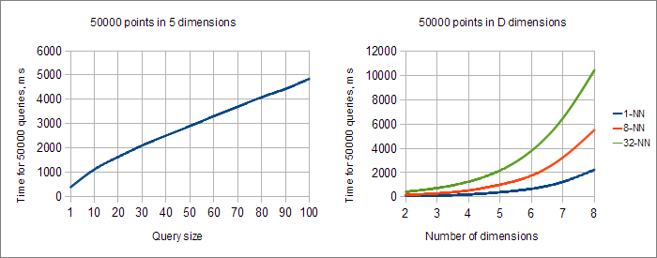
Complexity Analysis of NN Search in K-D tree
Query time exponentially grows as we increase the number of dimensions
https://www.alglib.net/other/nearestneighbors.php
150

Slide 151
主要内容
Nearest Neighbor Search
NN Search in Quad Tree
NN Search in K-D Tree
Quad Tree Construction
Exact Query
NN search in K-D Tree
Nearest Neighbor Query
Variants of NN Search
PCP Tree
Approximate NN in K-D Tree
ε‐Approximate NN in K-D Tree
151

Slide 152
K-Nearest Neighbor Search
Can find the k-nearest neighbors to a query by maintaining the k current bests instead of just one.
Branches are only eliminated when they can't have points closer than any of the k current bests.
The complexity is O(k (2^{d}+logn)) which is not suitable when d is large. It is O(k logn) when d is a considered as a constant.
Note that the region query has complexity O(n^{1-1/d}+ k)，
152

Slide 153

KD variations - PCP Trees
Splits can be in directions other than x and y.
Divide points perpendicular
to the axis with widest
spread.
Principal Component
Partitioning (PCP)
153

Slide 154

KD variations - PCP Trees
154

Slide 155
“Curse” of dimensionality
KD-trees are not suitable for efficiently finding the nearest neighbor in high dimensional spaces.
Approximate Nearest-Neighbor (ANN)
Examine only the N closest bins of the kD-tree
Use a priority queue to identify bins in order by their distance from query.
Return nearest-neighbors with high probability (e.g., 95%).
Range query time: O(n^{1-1/d}+k)
K-NN query time: O(k (2^{d}+logn))
J. Beis and D. Lowe, “Shape Indexing Using Approximate Nearest-Neighbour Search in High-Dimensional Spaces”, IEEE Computer Vision and Pattern Recognition, 1997.
155

Slide 156
Approximate Nearest-Neighbor (ANN)
Examine only the N closest bins of the kD-tree
Use a priority queue to identify bins in order by their distance from query.
Let the current best distance be D.
In backtracking, distances to bins are compared with D and bins with smaller distances are traversed.
将bins按照距离查询的距离排序
156
Notes:
A query point traverses the k‐d tree and records the distances to each split on a priority queue. Let D be the distance between the query point and the leaf. In backtracking, split distances recorded are compared with D and branches with smaller distance are traversed.

Slide 157
Approximate Nearest-Neighbor (ANN)Best Bin First
With Best Bin First, a query point first looks his containing bin (D) and then in its adjacent near bin (B), rather than its closest neigbour in the tree (C)
157

Slide 158
BBF can give speedup by factor of 1000‐5000 for database of 1 million points while finding nearest neighbor 95% of the times.
BBF search
Standard NN on K-d tree after examining Emax leaves.
Approximate NN lookup vs Emax . (100,000 stored points; dimension of space 12; averaged over 1000 queries. Emax (restricted) was 2.4 times Emax (BBF).)
158

Slide 159
BBF vs. restricted K-D tree NN search
BBF returns the closest neighbor 95% of the times.
159

Slide 160
BBF vs. K-D tree NN search vs. exhaustive search
Exact k-d tree search is not efficient in high dimension data
BBF is efficient.
160

Slide 161
Approximation ratio increases slowly with Dimension
Average of ratios of approximate to actual NN distance.
(100,000 stored points; Emax(BBF)=200; Emax(restricted)=480; averaged over 1000 queries.)
161

Slide 162
ε‐Approximate Nearest Neighbor
ε‐Approximate Nearest Neighbor finds the nearest neighbor with high probability, i.e. finds points p’ in P, whose distance to q is at most (1+ε) time the true nearest distance R.
It is a popular tool for fighting the curse of dimensionality.
162

Slide 163
Locality Sensitive Hashing (LSH)
Locality Sensitive Hashing (LSH) is a fast method for ε‐approximate Nearest Neighbor search in high dimensional space useful for large datasets [A. Gionis, P. Indyk, R. Motwani, 1999].
LSH constructs a set of locality‐sensitive hash functions such that the probability of nearby points being close after the transformation with the hash function is larger than the probability of two distant points being close after the same transformation.
We will introduce it in the next class.
163

